Slide 1
Exploring open source BI tools (Superset, Metabase)
Name: Prasiddha Bhat
Project ID: CO28 Project Area: Data Visualization

Slide 2
Project overview and objective
Exploration of open-source BI tools- Apache Superset and Metabase
Development of intuitive dashboards for visualization
Examine the crop production dataset from the Department of Agriculture & Farmers Welfare (DA&FW) to extract meaningful insights.
Recognize important metrics and trends within the dataset to support informed decision-making.
Compare the two tools
Embed the Dashboards

Slide 3
Dataset Overview
Source: Crop production dataset from the Department of Agriculture & Farmers Welfare (DA&FW)
Thirteen columns- Crop, Season, 11 years ranging 2013-14 to 2023-24.
Crops: food grains, oilseeds and other commercial crops
Seasons- Kharif, Rabi and Summer.
Years- numeric datatype, representing production in Lakh Tonnes, with some entries marked with ‘@’, ‘$’, or ‘#’ indicating inclusions.
Crop and Season: categorical

Slide 4
Data Preprocessing
Clean and prepare data for visualization
Replace special characters.
Reshape data
Standardize 'Year' column and remove redundant entries.

Slide 5
Installation
Docker Desktop
Superset
Metabase
MySQL Workbench
MySQL Server
MySQL Shell

Slide 6
Superset Dashboard
Superset offers 40+ pre-installed visualizations, drag-and-drop functionality, fast data loading, and SQL query support.
Visualizations used: Table, Line Chart, Pie Charts, Area Chart, Pivot Table, Big Number Charts, Bar Chart, Time-Series Line Chart, Bullet Chart, Nightingale Rose Chart, Sunburst Chart, Gauge Chart, Word Cloud, Tree Map, Heatmap.
Includes native filters for Season, Crop, and Year to refine insights.
Organized into Overview and Exploratory tabs for easy navigation. The live CSS editor was used for visual enhancements and annotations were added to make the charts more informative.
Role-based access: Gamma role

Slide 7
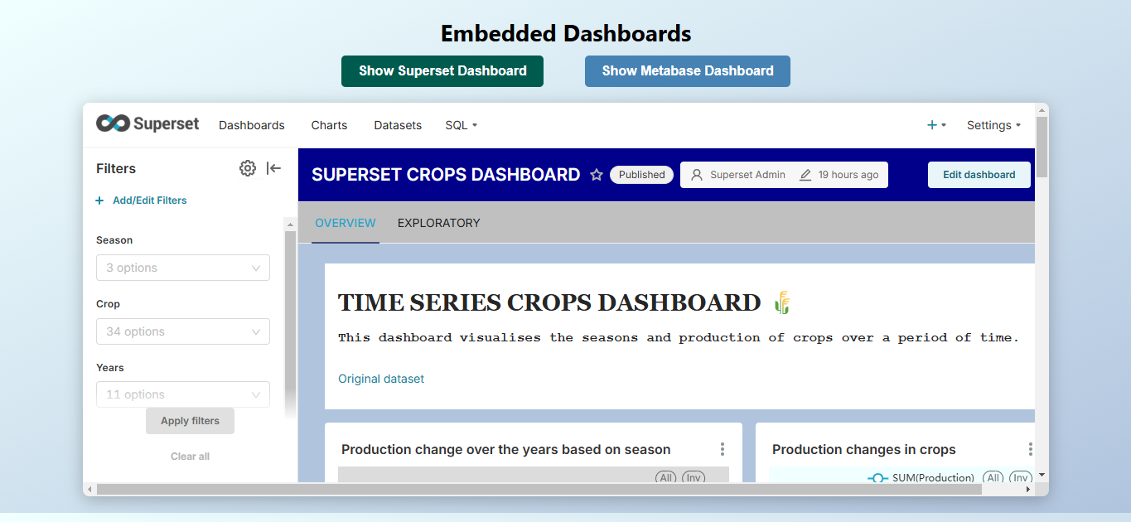
Superset Dashboard

Slide 8

Superset Dashboard

Slide 9
Metabase Dashboard
Focuses on intuitive design that allows users of all technical backgrounds to gain insights without needing extensive skills.
Visualizations used: Big Number Charts, Table, Pie Charts, Pivot Table, Row Chart, Bar Chart, Waterfall Chart, Line Charts.
Includes native filters for Season, Crop, and Year to refine insights.
Organized into Overview and Exploratory tabs for easy navigation. Users can add link cards, hide empty cards to enhance usability and annotations to make the charts more informative.
Drill-down features

Slide 10
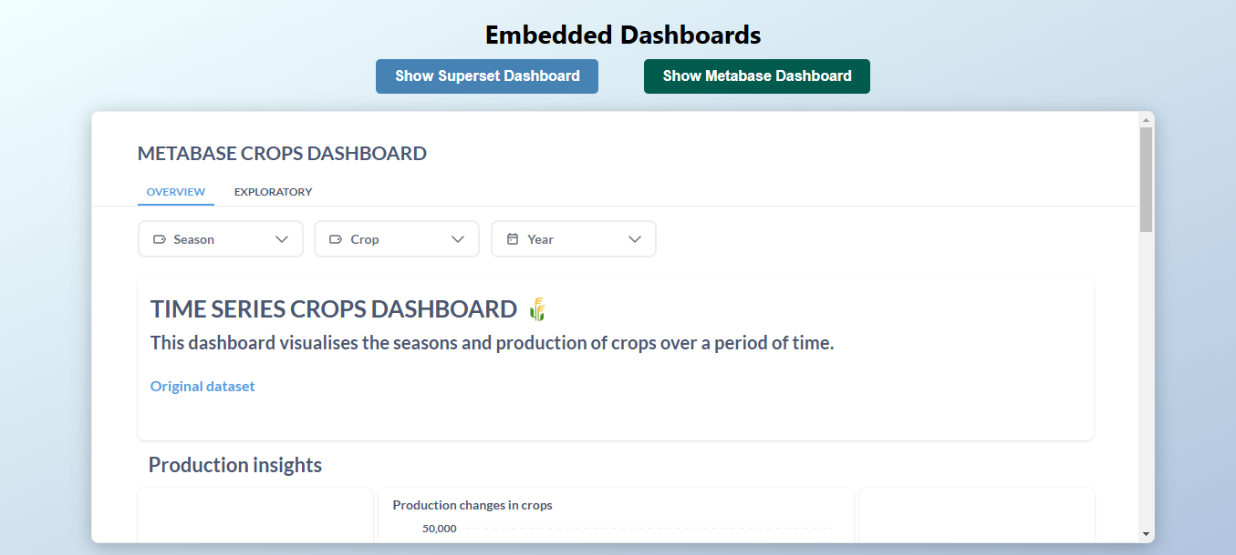
Metabase Dashboard

Slide 11

Metabase Dashboard

Slide 12
Embedding
Superset Setup: Create superset_config.py, mount in Docker, Restart superset.
Metabase Setup: Enable embedding in Admin settings, copy public embed link.
Web Page Design
Embedding using iframes in HTML.
Local Hosting: Use Python HTTP server (python -m http.server 8000), access at localhost:8000.

Slide 13
Comparison: Metabase Vs Superset
FEATURE | METABASE | SUPERSET
Visualization | Basic charts and dashboard, about 20 default charts | Very broad range of visualization types, over 60 default charts
Scalability | For small-medium sized business | For large organizations
User capability | Focuses heavily on empowering non-technical users. | Users might require technical expertise and some SQL knowledge.
Setup | Faster, simple and straightforward setup | Takes longer to setup; Steeper learning curve
Predictive Analytics | Limited | Can integrate with machine learning models
HTML embedding | Does not support | Supports
CSS customizations | Limited customization; Predefined themes | Extensive customization available; Has live CSS editor
User interface | Intuitive and simple user interface | Comprehensive user interface

Slide 14
Use cases- Superset
Customer Support: Analytics on support metrics. Superset’s advanced SQL capabilities and customizable visualizations empower support teams to conduct in-depth analyses of performance metrics, leading to more effective strategies for improving customer service.
Healthcare: Visualization of patient outcomes and treatment effectiveness. Superset's robust analytical features and flexibility make it suitable for healthcare organizations needing detailed visualizations and complex queries to evaluate treatment success and optimize patient care.

Slide 15
Use cases- Metabase
E-commerce: Sales performance analysis. Metabase’s user-friendly interface allows non-technical team members to easily generate reports and visualize sales data, making it ideal for rapid decision-making without the need for complex queries.
Finance: Risk and portfolio performance tracking. The simplicity of Metabase enables finance teams to create interactive dashboards and filter data quickly, ensuring that insights into financial risks and performance are accessible to all team members.

